Slide 1


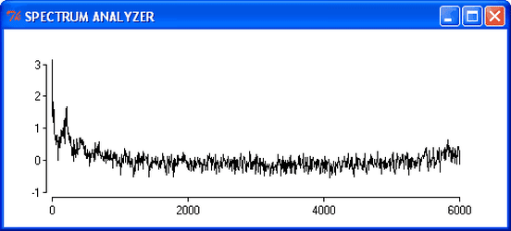
Lab 11 – FFT and Fourier Series
Objective:
The objective of this lab is to study the frequency response of the modified Audio amplifier front end using the FFT feature of the oscilloscopes.

Slide 2
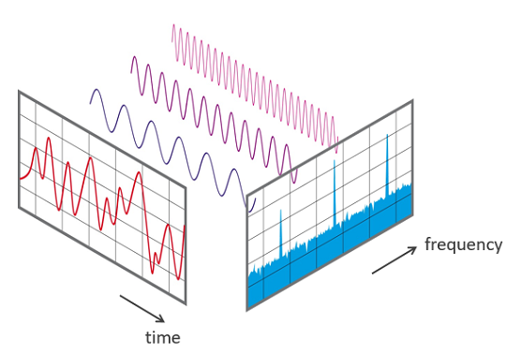
FFT
It is a measurement method in the science of audio.
It converts a signal into individual spectral components and provides frequency information about the signal.
It is an optimized algorithm for the implementation of the (DFT).

Slide 3
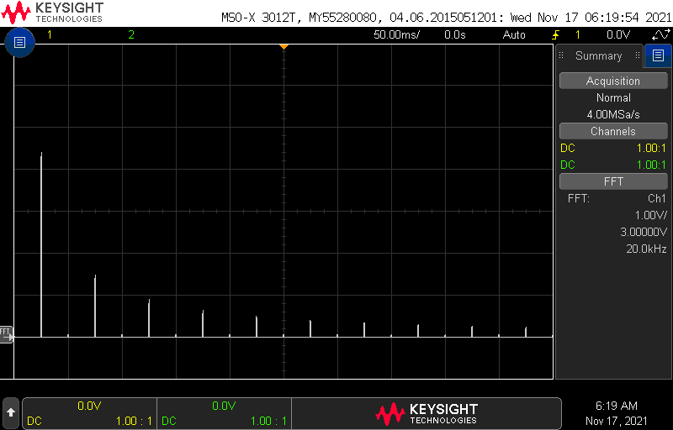
FFT
Here is the FFT of a 1kHz square wave, where the vertical axis is the voltage at that frequency.
The horizontal axis is scaled at 2kHz/div.
Notes:
In this figure, the vertical units are measured in decibels, where 0dBV is the amplitude of a 1Vrms sine wave.
The 0dBV reference is indicated by the grey reference arrow on the left side of the screen.
This spike represents the energy of the 1kHz sine wave being input to the system.
There are also 2 smaller spikes at 2kHz and 3kHz. These are unwanted harmonics of the fundamental 1kHz.

Slide 4
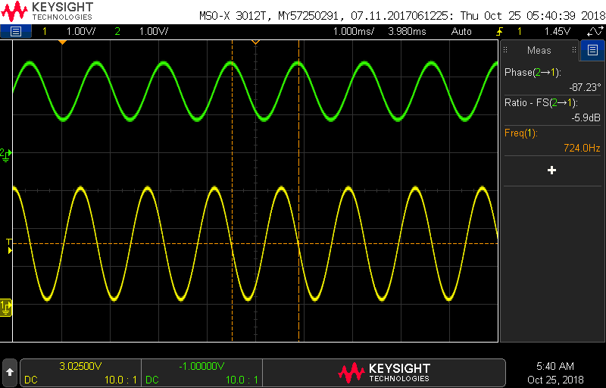
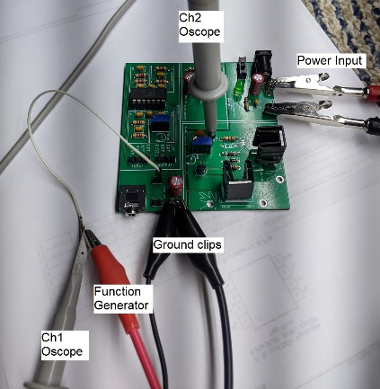
Frequency response of Audio amplifier
Last week, you increased the capacitance of the by-pass capacitor for the front end of the Audio amplifier.
Today, you will create a Bode plot to check how much the corner frequency has been reduced.
Notes:
This reduced the corner frequency of the unintended high-pass filter.

Slide 5
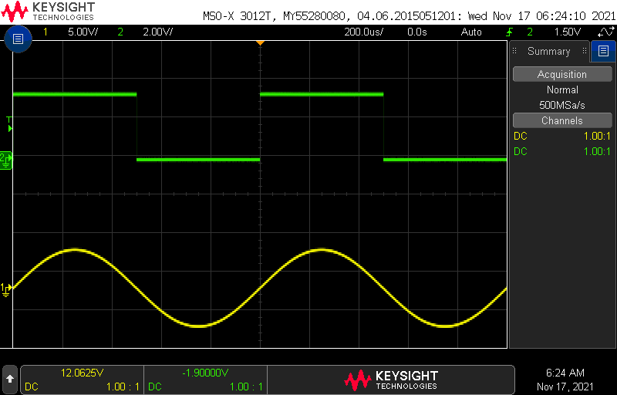
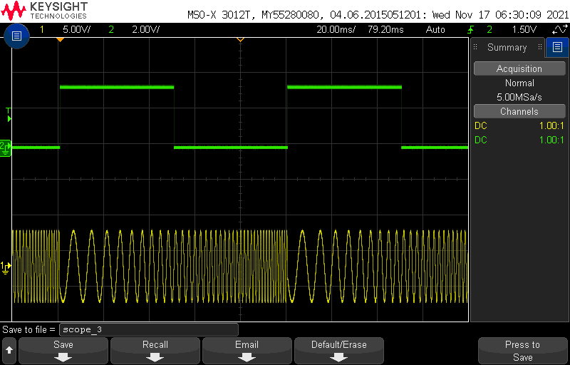
Generating a Bode plot using the o’scope
Use the function generator and o’scope together to generate a Bode plot.
You will use a new features of the function generator: the trigger output.

Slide 6
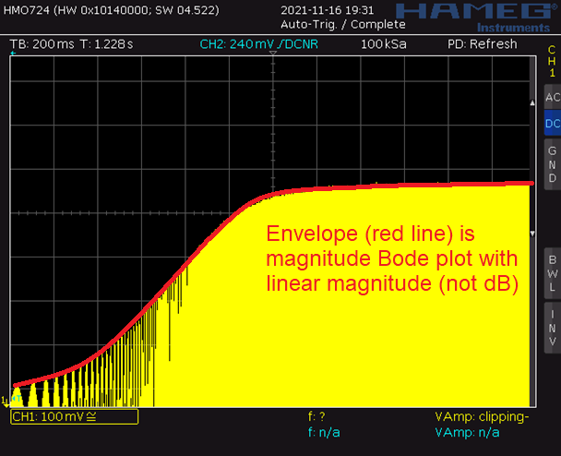
Generating a Bode plot using the o’scope
Horiz offset: Start of the sweep on the left side of the screen
Horiz scale: Large as possible for one sweep
Vert offset: Middle of sinusoid output is at bottom
Vert scale: Large as possible

Slide 7
Turn in
Fast Fourier Transform/ Fourier Series
  Table 1
Frequency response of Audio amplifier front end
  audioBoardBehavior Magnitude plot front-end
  (old & new)
Generating a Bode plot using the oscilloscope
  pseudo-Bode plot screen shot from oscilloscope

